Slide 1
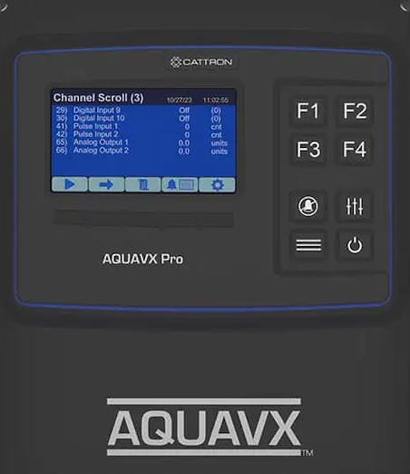
Function Keys
Pause
Alarms
Outputs
Power
Channel
Scroll
play/pause
Manual
Scroll
Admin
Log in
Alarm
Screen
Channel
List
Configuration
And System Status

